Slide 1

Gokaraju Rangaraju Institute of Engineering and Technology
welcomes
NAAC Expert Team
19 Feb 2021
Advanced Academic Center
1

Slide 2

Advanced Academic Center
A center for interdisciplinary research
2

Slide 3
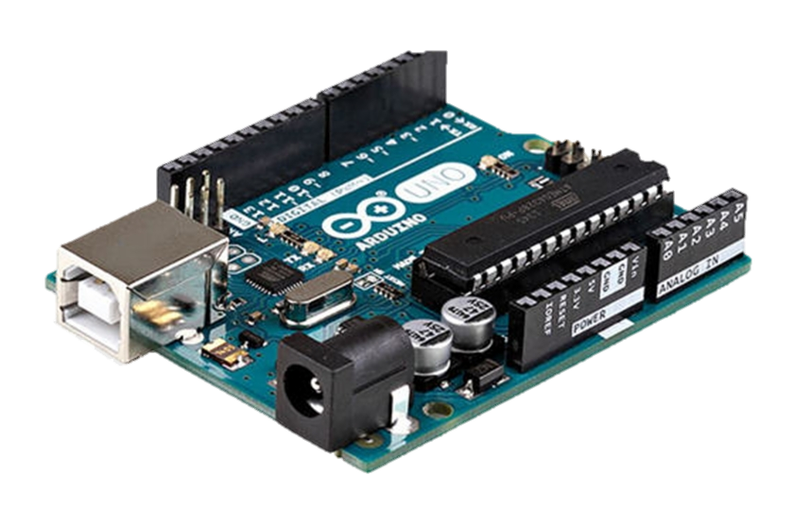
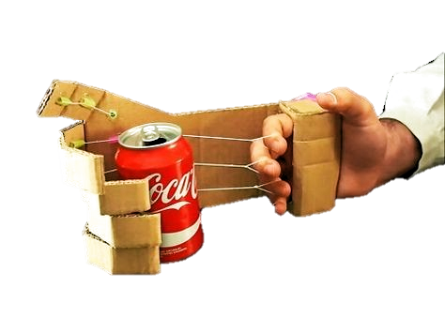
“ROBOTIC ARM POWERED BY EMG”
1

Slide 4
ABSTRACT:
There is no commercially available solution for the paralyzed. The prosthetic limbs available for the amputees in the market are too expensive and only available in developed countries. With our project, we provide an affordable solution for the upper limb amputees.
We made cardboard cutout of an arm, with sufficient space to accommodate the required circuitry within the cardboard model itself to eliminate the hassle of wires.
Using a cardboard model also helped us to greatly reduce the overall cost of the project without compromising on the durability of the model.
The cardboard arm contains a breadboard on the side, which is used to provide the necessary connections between the arm, servo motors, Arduino board, and the EMG sensor.
The motion of the fingers is controlled by strings wound over each finger, which are in turn connected to servo motors.

Slide 5
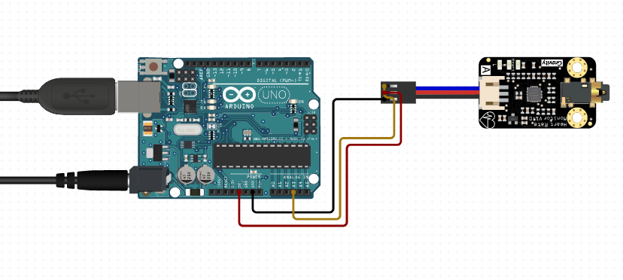
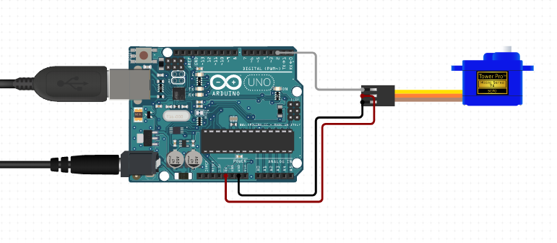
CONNECTIONS:
ARDUINO TO EMG SENSOR
ARDUINO TO SERVO MOTORS
+ve terminal of battery to +Vs pin of EMG
-ve terminal of battery to –Vs pin of EMG
Sig pin of EMG to any analogue pin
GND of Arduino to GND of EMG
PWM pin of Arduino to Sig pin of Servo
5V pin of Arduino to Source pin of Servo
GND pin of Arduino to GND of Servo

Slide 6
Working is simple : Based on our muscle movement, the sensor will decide weather a servo motor should rotate or not. These servo motors are used for movement of the fingers. Most of the wiring is for connecting electrode to our arm which can be covered by our shirt. Our model is working effectively even for kids. Working video was done by connecting the electrodes to a 6th class kid.

Slide 7
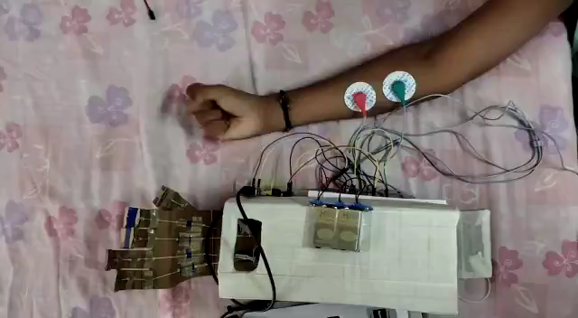
WORKING MODEL :

Slide 8


